Slide 1
Machine Learning 03- Model Predictions
Dr. Malak Abdullah
Computer Science Department
Jordan University of Science and Technology

Slide 2
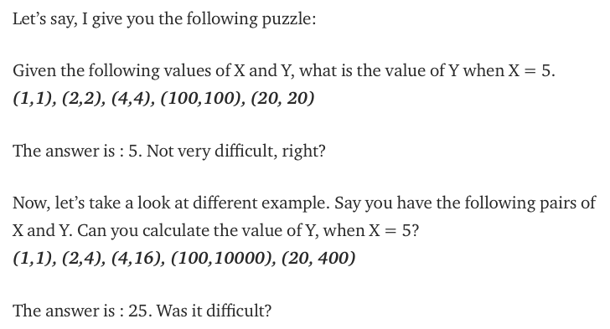
Before we start!
The relationship between X and Y is Y = X
The relationship is Y = X*X
What about (1,1), (2,5), (4,15), (5,27),(10,1005)?

Slide 3
Overall, machine learning works in the same way!
Your computer looks at some examples and then tries to identify “the most suitable” relationship between the sets X and Y.
Using this identified relationship, it will try to predict (or more) for new examples for which you don’t know Y.

Slide 4
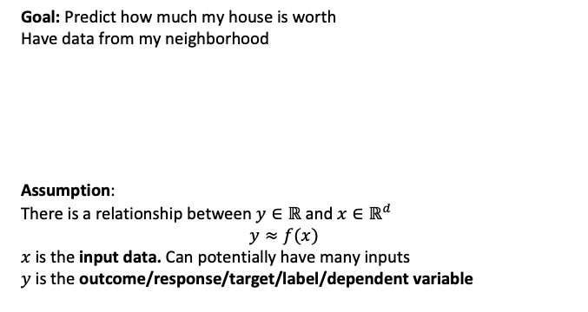
Fitting Data
Goal: Predict how much my house is worth
Have data from my neighborhood
Assumption:
There is a relationship between $y∈ℝ$ and $x∈ℝ^{d}$
$$y≈f(x)$$
$x$ is the input data. Can potentially have many inputs
$y$ is the outcome/response/target/label/dependent variable

Slide 5
What is Regression?
Regression is usually termed as determining relationship(s) between two or more variables.
X and Y are the variables, X is termed as the independent variable and Y is termed as the dependent variable and Y has a continuous range (unlike classification where Y is discrete).
If we had multiple input attributes (e.g. x1, x2, x3, etc.) This would be called multiple linear regression.

Slide 6
The machine learning framework
y = f(x)
output
prediction function
Image feature
Training: given a training set of labeled examples {(x₁,y₁), …, (x_{N},y_{N})}, estimate the prediction function f by minimizing the prediction error on the training set
Testing: apply f to a never-before-seen test example x and output the predicted value y = f(x)
Slide credit: L. Lazebnik

Slide 7
Types of Regression Models
1 Explanatory Variable
Regression
2+ Explanatory Variables
Models
Simple
Multiple
Non-
Non-
Linear
Linear
Linear
Linear
Notes:
24
This teleology is based on the number of explanatory variables & nature of relationship between X & Y.

Slide 8
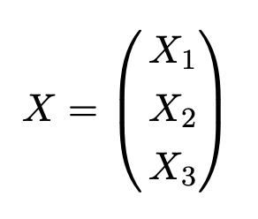
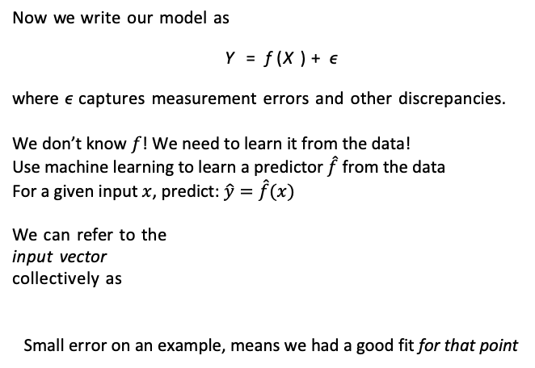
Prediction
Now we write our model as
Y = f (X) + ϵ
where ϵ captures measurement errors and other discrepancies.
We don’t know $f$! We need to learn it from the data!
Use machine learning to learn a predictor $\hat{f}$from the data
For a given input $x$, predict: $\hat{y}=\hat{f}(x)$
We can refer to the
input vector
collectively as
Small error on an example, means we had a good fit for that point

Slide 9
Basic Idea
Try a bunch of different lines and see which one is best!
What does best even mean here?

Slide 10
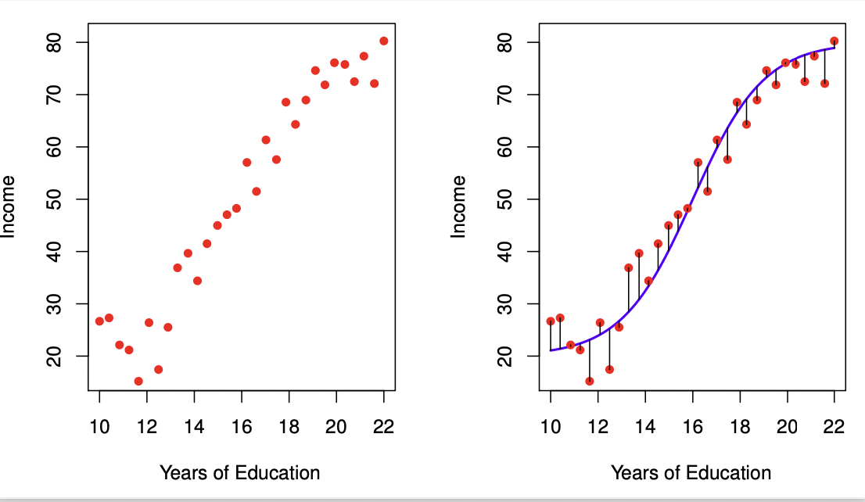
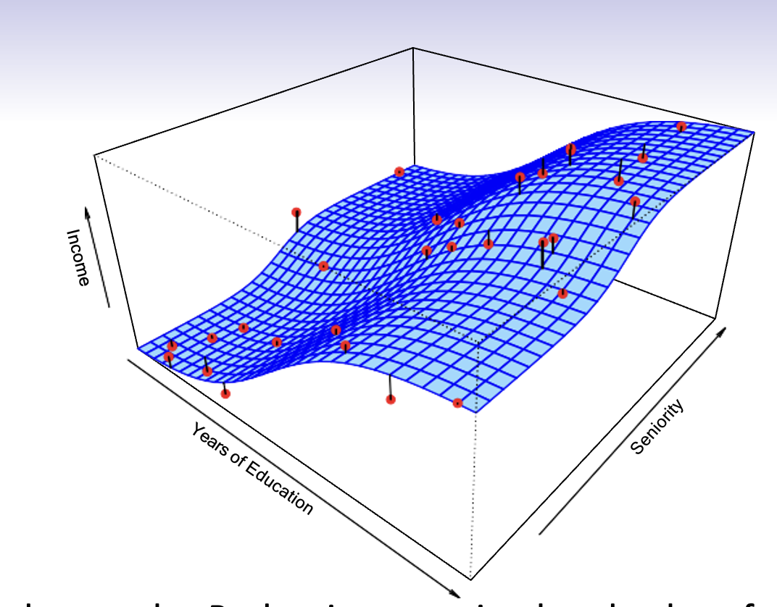
What is f (X) good for?
With a good f, we can make predictions of Y at new points
X = x.
We can understand which components of
X = (X₁, X₂, . . . , X_{p}) are important in explaining Y, and which are irrelevant. e.g. Seniority and Years of Education have a big impact on Income, but Marital Status typically does not.
Depending on the complexity of f, we may be able to understand how each component X_{j} of X affects Y.
10 / 30

Slide 11
6
●●
● ●
●●
● ● ●
●●● ● ●
4
●●●●●●●●●●
● ●●● ● ●
● ●●●●●●●●● ●
●
● ●●●●●●
●●●●●●●●●● ●●
●●●●●● ●●●●●
●●
●●●●●●●●●●●●●
y
● ●●●●●●●●●●●●●●●
2
● ●●●●●●●●● ●●●●●●●
● ●●●●●●●●●●●●●● ●
●
●●●●●●●●●●●●●●●●●●●●●●●●
●●●●●●●●●●●●●●●● ●●●●● ●
●
●
●●●●●●●●●●●●●●●●●●●●●●●●●
●
● ●●●●●●●●●●●●●●●●●●●●●●●●●●●●●
● ●
● ●●●●●●●●●●●●●●●●●●●●●●●●●●●
● ●
●●● ●●●●●●●●●●●●●●●●●●●●● ●●●●●●●●●●●●●●●●●●
●
●●
●● ●●●●●●●●● ●●●●●●●●●●●●●●● ●●●●●●
−2 0
● ●●● ● ●●●● ●●●●●●● ●●●●● ●●●●●●●●●●●●●●●●●●●●●
●● ●●● ●●● ●●● ●●●●●●●●●●●●●●●●●●●●●●●●●● ●●●●●●●●●●●●●●
● ● ●●●●●●●●●●●●●●●●●●●●●●●●●●●●●●●●●●●●●●●●●●●● ●●●
●● ●●●●●●●●●●●●●●●●●●● ●●● ●●● ●●●●●●●●●●●●●●●●●
●●●●● ●●●●●●●●●●●●●●●●●●●●●●●●●●●●●●●● ●
●●● ●●●●● ●●●●●●●●●●●●●●●●● ●● ●●● ●
●● ●●●●●●●●●●●●●●● ● ●●●●●
● ● ●●●●●●●●●●● ●●● ●● ●
●
●● ● ●●
1
2
3 4
x
5
6
7
Is there an ideal f (X)? In particular, what is a good value for f (X) at any selected value of X, say X = 4? There can be many Y values at X = 4. A good value is
f (4) = E(Y |X = 4)
E(Y |X = 4) means expected value (average) of Y given X = 4.
This ideal f (x) = E(Y |X = x) is called the regression function.
4 / 30

Slide 12
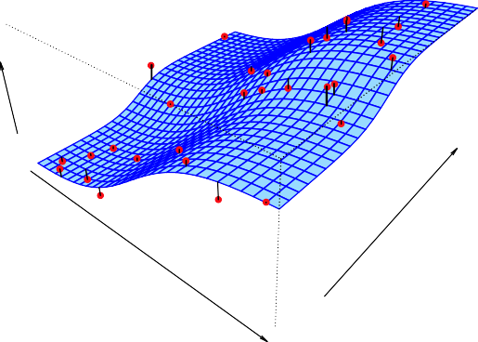
Income
Seniority
Years of Education
Simulated example. Red points are simulated values for income
from the model
income = f (education, seniority) + ϵ f is the blue surface.

Slide 13
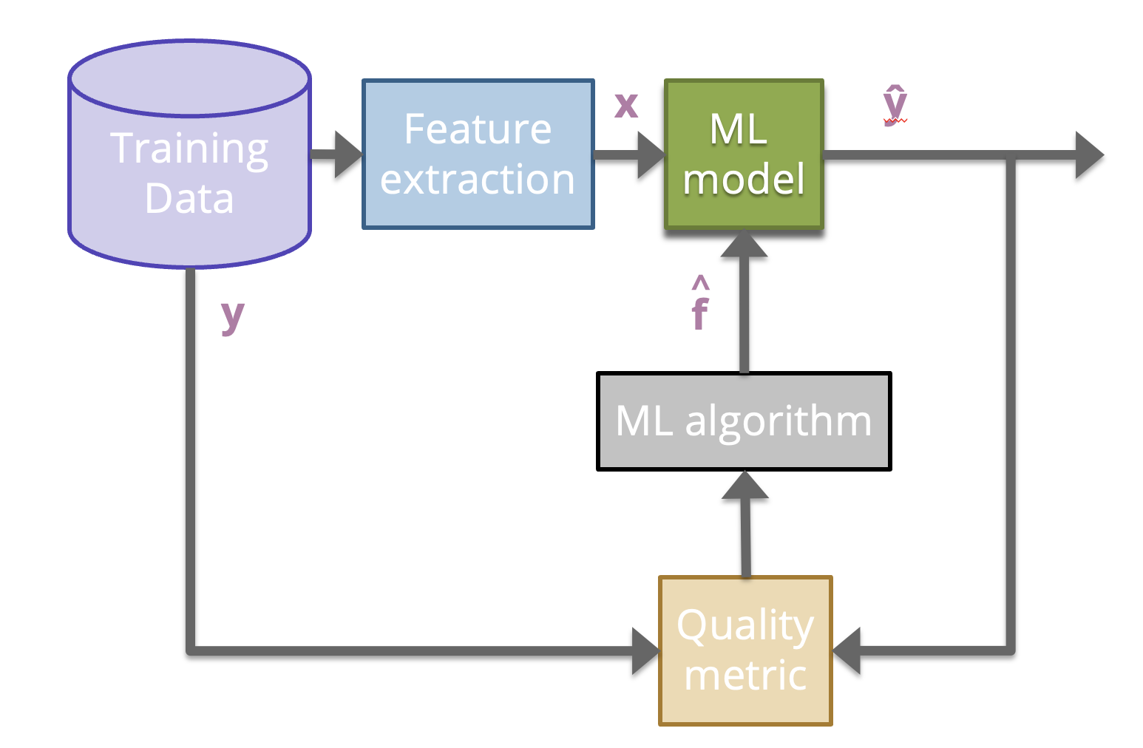
ML Pipeline

Slide 14
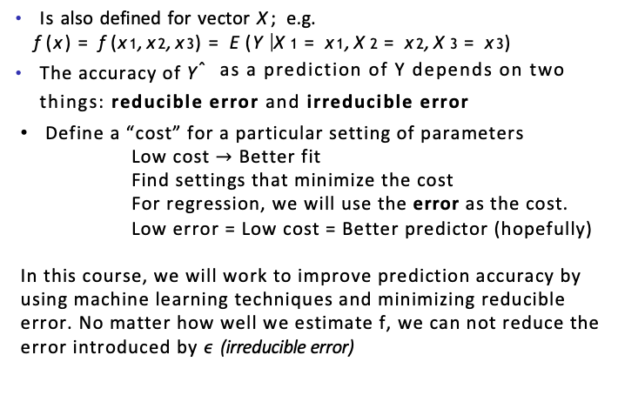
The regression function f (x)
Is also defined for vector X; e.g.
f (x) = f (x₁, x₂, x₃) = E(Y |X₁ = x₁, X₂ = x₂, X₃ = x₃)
The accuracy of Yˆ as a prediction of Y depends on two things: reducible error and irreducible error
Define a “cost” for a particular setting of parameters
Low cost $→$ Better fit
Find settings that minimize the cost
For regression, we will use the error as the cost.
Low error = Low cost = Better predictor (hopefully)
In this course, we will work to improve prediction accuracy by using machine learning techniques and minimizing reducible error. No matter how well we estimate f, we can not reduce the error introduced by ϵ (irreducible error)

Slide 15
How Do we estimate f?
Parametric methods: The linear model is an important example of a parametric model :
f_{L}(X) = β₀ + β₁X₁ + β₂X₂ + . . . β_{p}X_{p}.
A linear model is specified in terms of p + 1 parameters
β₀, β₁, . . . , β_{p}.
We estimate the parameters by fitting the model to training data.
Although it is almost never correct, a linear model often serves as a good and interpretable approximation to the unknown true function f (X).
Some more examples of parametric machine learning algorithms include Logistic Regression, Naive Bayes, and Simple Neural Networks.

Slide 16
A linear model f^{ˆ}_{L}(X) = β^{ˆ}₀ + β^{ˆ}₁X gives a reasonable fit here
−2 −1 0 1 2 3
● ●
●
●
●●
●
●
●
● ●
●
●●
●
●
● ● ●●
● ●●●
y
●
●
● ●● ●●
●
●
●
●
●
● ●
● ●●
●
●
● ● ●
●
● ●
●
● ●●
● ● ● ●
● ●● ●●
● ● ●
●
1 2 3 4 5 6
x
A quadratic model f^{ˆ}_{Q}(X) = β^{ˆ}₀ + β^{ˆ}₁X + β^{ˆ}₂X² fits slightly better.
−2 −1 0 1 2 3
● ●
●
●
●●
●
● ●
● ●
●●
● ●●●
●
● ●
y
●
● ● ●●
●● ●●
●
●
● ●
● ●
● ●●
●
● ●
●
● ● ●
●
● ●
●
●
● ●●
● ● ● ●
● ●● ●●
● ● ●
●
1
2
3
4
5
6
x

Slide 17
Income
Seniority
Years of Education
Simulated example. Red points are simulated values for income
from the model
income = f (education, seniority) + ϵ f is the blue surface.

Slide 18
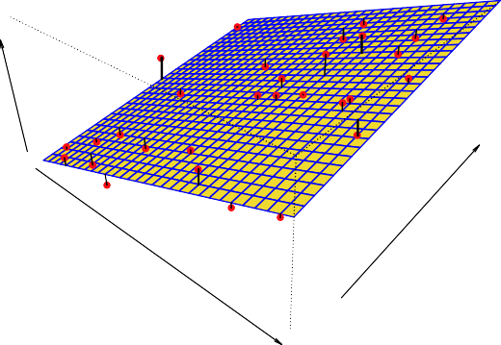
Income
Seniority
Years of Education
Linear regression model fit to the simulated data.
f^{ˆ}_{L}(education, seniority) = β^{ˆ}₀+β^{ˆ}₁×education+β^{ˆ}₂×seniority

Slide 19
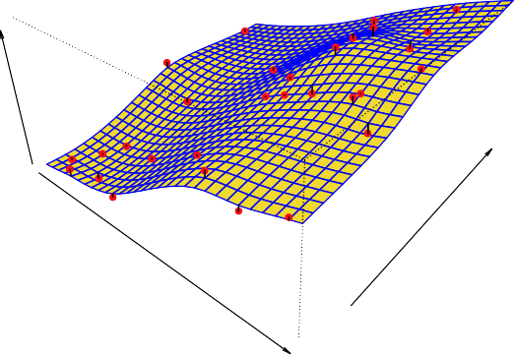
Income
Seniority
Years of Education
More flexible regression model f^{ˆ}_{S} (education, seniority) fit to the simulated data. Here we use a technique called a thin-plate spline to fit a flexible surface. We control the roughness of the fit (chapter 7).

Slide 20
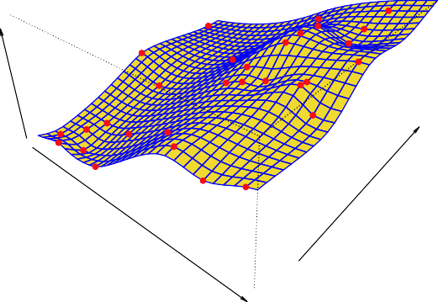
Income
Seniority
Years of Education
Even more flexible spline regression model
f^{ˆ}_{S} (education, seniority) fit to the simulated data. Here the fitted model makes no errors on the training data! Also known as overfitting.

Slide 21
How Do we estimate f?
Non-Parametric methods: An easy-to-understand nonparametric model is the k-nearest neighbors algorithm that makes predictions based on the k most similar training patterns for a new data instance. The method does not assume anything about the form of the mapping function other than patterns that are close are likely to have a similar output variable.
Some more examples of popular nonparametric machine learning algorithms are:
k-Nearest Neighbors
Decision Trees like CART and C4.5
Support Vector Machines

Slide 22
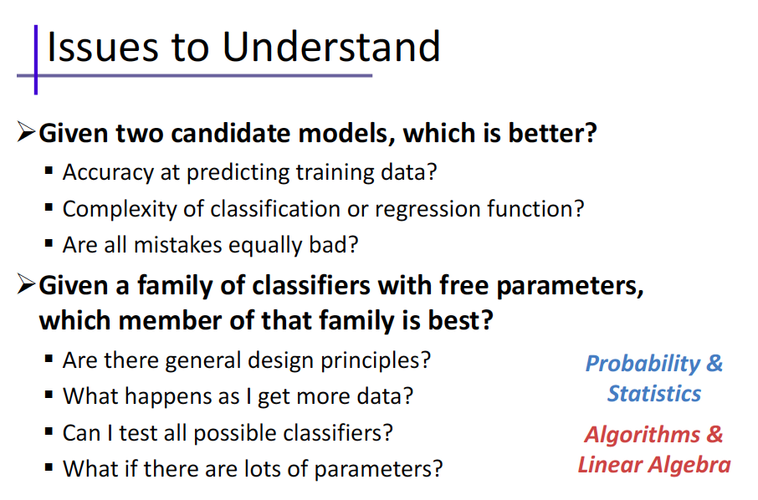

Slide 23
Generalization
Definition: model does a good job of correctly predicting class labels of previously unseen samples
Generalization is typically evaluated using a test set of data that was not involved in the training process
Evaluating generalization requires:
Correct labels for test set are known.
A quantitative measure (metric) of tendency for model to predict correct labels.

Slide 24
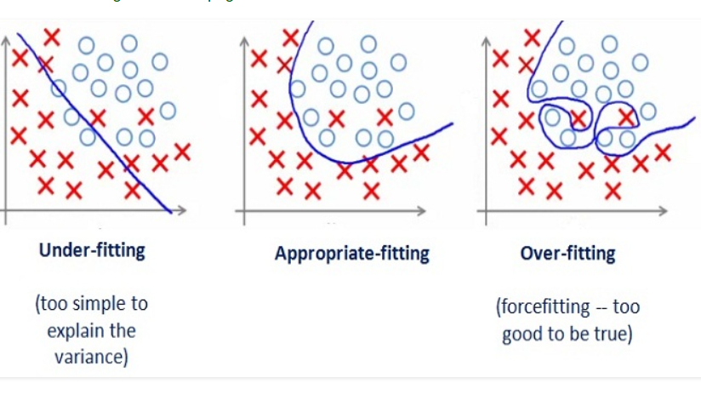
Generalization
Underfitting: model is too “simple” to represent all the relevant class characteristics
Overfitting: model is too “complex” and fits irrelevant characteristics (noise) in the data

Slide 25
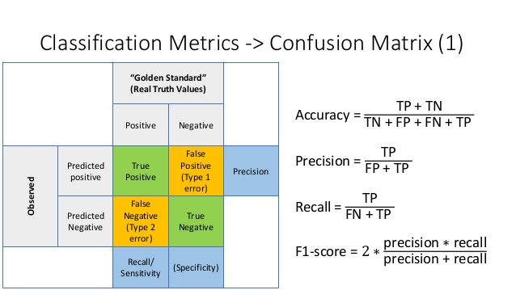
Metrics for classifier performance
Confusion Matrix is a performance measurement for machine learning classification.
Notes:
Metrics for classifier performance can be used on any labeled partition of the data: training, validation, or test.

Slide 26
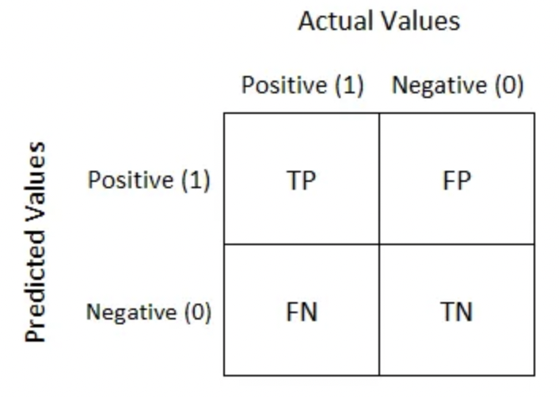
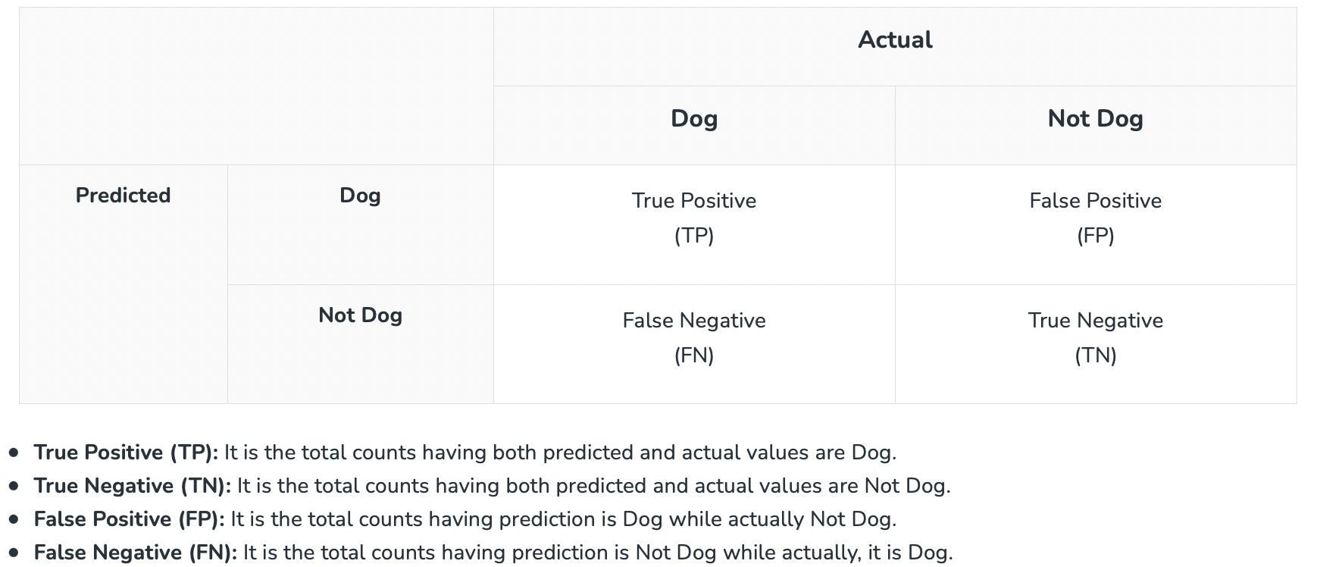
Confusion Matrix
The matrix displays the number of instances produced by the model on the test data.
True positives (TP): occur when the model accurately predicts a positive data point.
True negatives (TN): occur when the model accurately predicts a negative data point.
False positives (FP): occur when the model predicts a positive data point incorrectly.
False negatives (FN): occur when the model mispredicts a negative data point.
Example

Slide 27
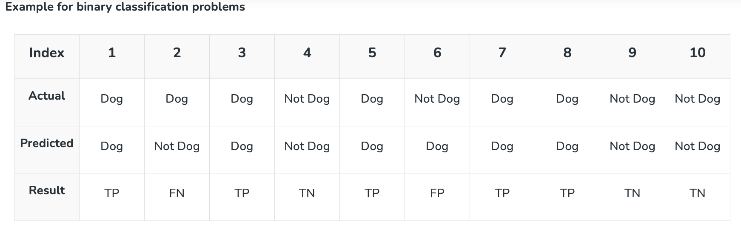
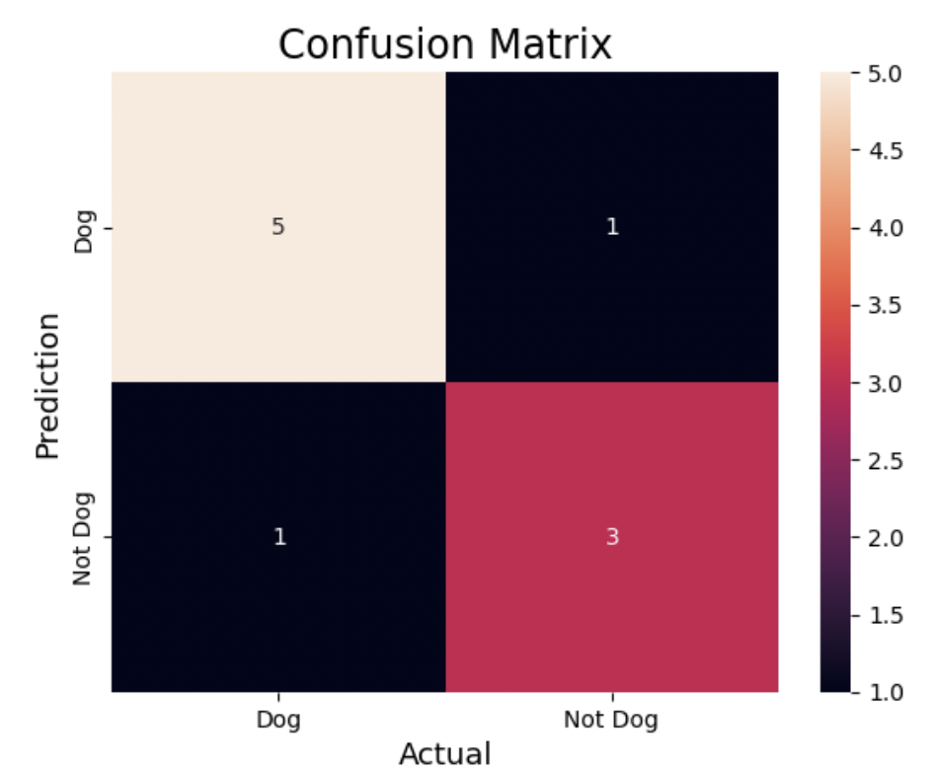
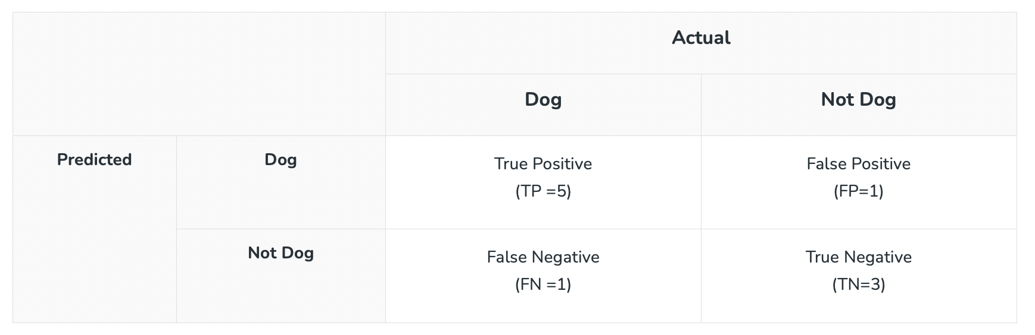
Actual Dog Counts = 6
Actual Not Dog Counts = 4
True Positive Counts = 5
False Positive Counts = 1
True Negative Counts = 3
False Negative Counts = 1

Slide 28
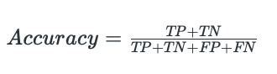
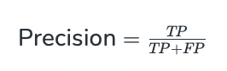
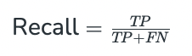
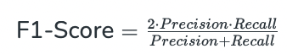
1. Accuracy
Accuracy is used to measure the performance of the model. It is the ratio of Total correct instances to the total instances.
For the above case:
Accuracy = (5+3)/(5+3+1+1) = 8/10 = 0.8
2. Precision
is a measure of how accurate a model’s positive predictions are. It is defined as the ratio of true positive predictions to the total number of positive predictions made by the model.
Precision = 5/(5+1) =5/6 = 0.8333
3. Recall
measures the effectiveness of a classification model in identifying all relevant instances from a dataset. It is the ratio of the number of true positive (TP) instances to the sum of true positive and false negative (FN) instances.
Recall = 5/(5+1) =5/6 = 0.8333
4. F1-Score
is used to evaluate the overall performance of a classification model. It is the harmonic mean of precision and recall,
F1-Score: = (2* 0.8333* 0.8333)/( 0.8333+ 0.8333) = 0.8333
We balance precision and recall with the F1-score when a trade-off between minimizing false positives and false negatives is necessary, such as in information retrieval systems.

Slide 29
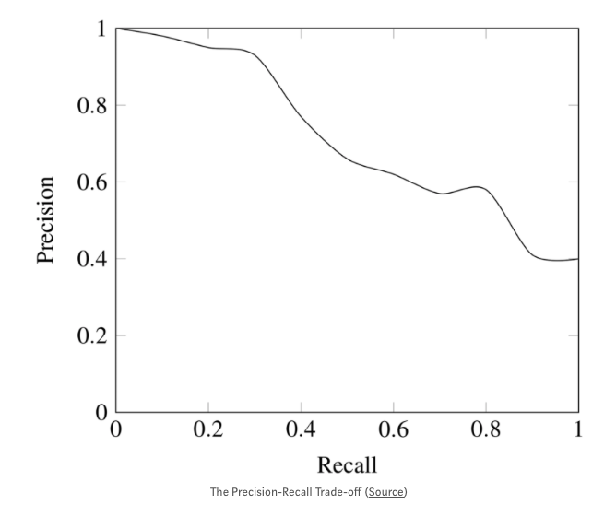
Trade-off
While recall expresses the ability to find all relevant instances in a dataset, precision expresses the proportion of the data points our model says was relevant actually were relevant.
Accuracy should NEVER be used as a measure when the target variable classes in the data are a majority of one class.
Ex: In our cancer detection example with 100 people, only 5 people has cancer. Let’s say our model is very bad and predicts every case as No Cancer. In doing so, it has classified those 95 non-cancer patients correctly and 5 cancerous patients as Non-cancerous. Now even though the model is terrible at predicting cancer, The accuracy of such a bad model is also 95%.

Slide 30

How to evaluate your model
Example: A school is running a machine learning primary diabetes scan on all of its students. The output is either diabetic (+ve) or healthy (-ve).
Accuracy answers the following question: How many students did we correctly label out of all the students?
Precision answers the following: How many of those who we labeled as diabetic are actually diabetic? = TP / (TP+FP)
Recall answers the following question: Of all the people who are diabetic, how many of those we correctly predict? = TP / (TP+FN)

Slide 31
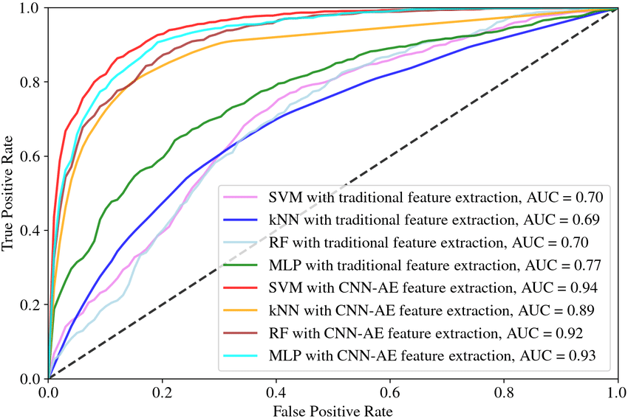
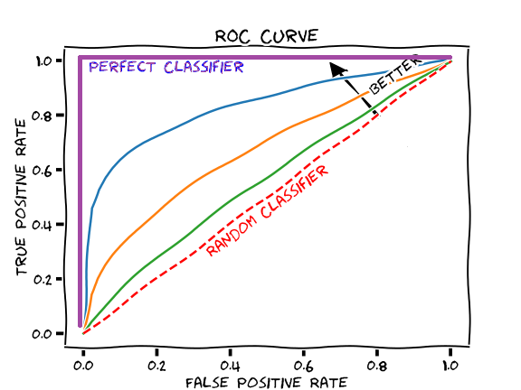
ROC AUC
A receiver operating characteristic curve→ ROC curve
Area under the ROC Curve → AUC

Slide 32
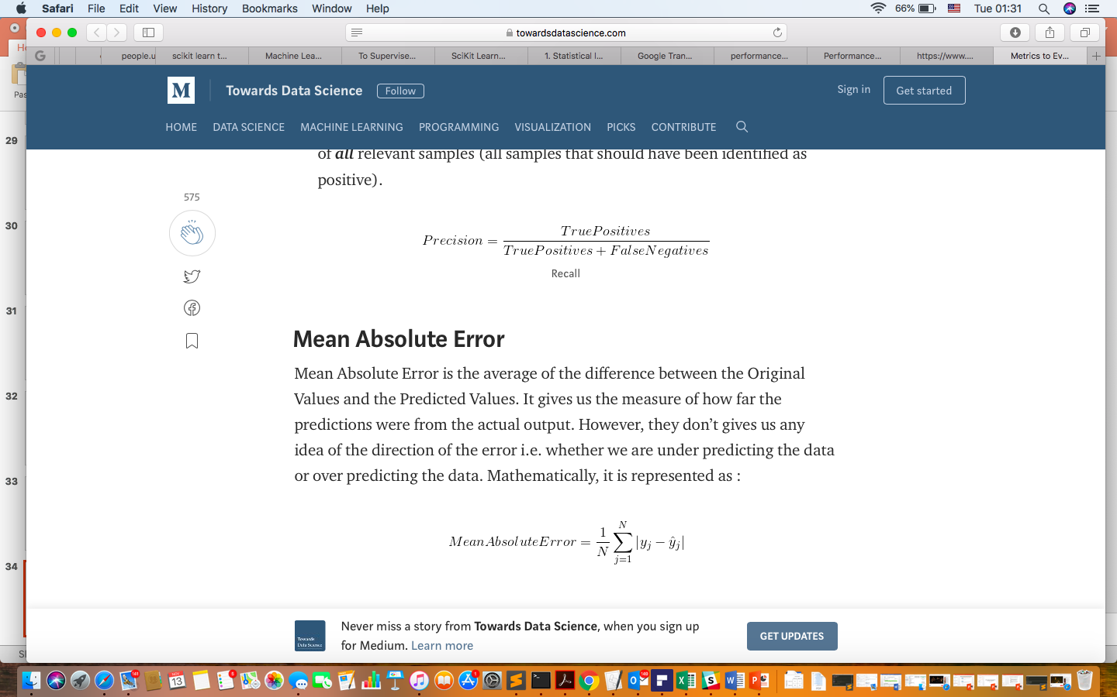
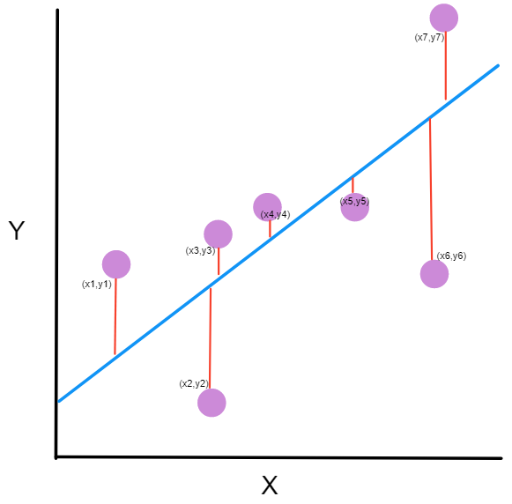
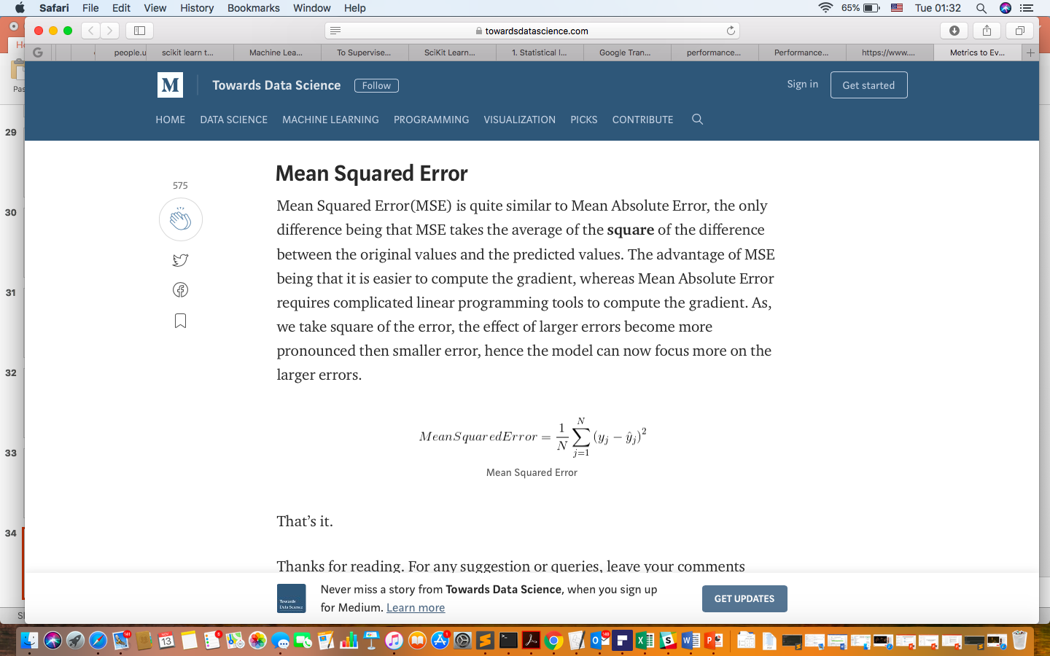
How to evaluate your Regression model
1.
2.

Slide 33
Some trade-offs
Prediction accuracy versus interpretability.
Linear models are easy to interpret; thin-plate splines are not.
Good fit versus over-fit or under-fit.
How do we know when the fit is just right?
Parsimony versus black box.
We often prefer a simpler model involving fewer variables over a black-box predictor involving them all.

Slide 34
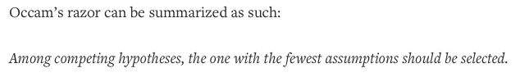
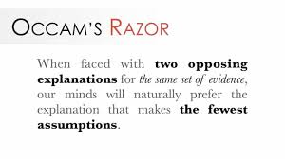
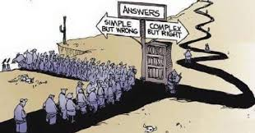
Occam’s Razor
Given two models with similar generalization errors, one should prefer the simpler model over the more complex model.
For complex models, there is a greater chance it was fitted accidentally by errors in data.
Model complexity should therefore be considered when evaluating a model.

Slide 35
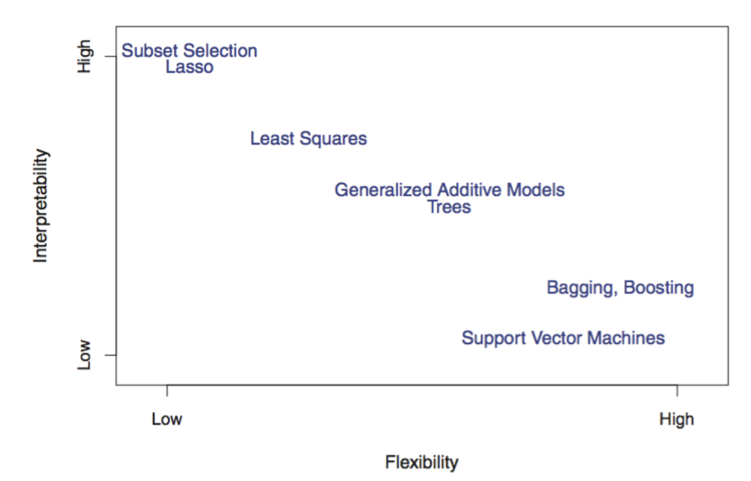
Trade-off
Flexibility determines how wiggly the model is. The second tell us how interpretable the model is. Flexible models cover a wider range of possibilities. Interpretable models are easier to understand.

Slide 36
Assessing Model Accuracy
Suppose we fit a model f^{ˆ}(x) to some training data
N
Tr = {x , y } , and we wish to see how well it performs.
i i
1
We could compute the average squared prediction error over Tr:
MSE_{Tr} = Ave_{i∈Tr}[y_{i} − f^{ˆ}(x_{i})]²
This may be biased toward more overfit models.
Instead we should, if possible, compute it using fresh test
M
data Te = {x , y } :
i i
1
MSE_{Te} = Ave_{i∈Te}[y_{i} − f^{ˆ}(x_{i})]²

Slide 37
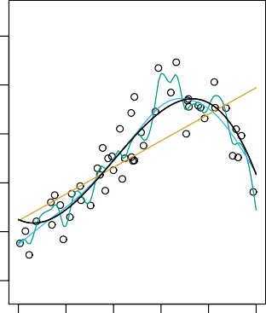
2.5
12
2.0
10
Mean Squared Error
1.5
8
Y
6
1.0
4
0.5
2
0.0
0
20
40
60
80 100
2
5
10 20
X Flexibility
Black curve is truth. Red curve on right is MSE_{Te}, grey curve is MSE_{Tr}. Orange (underfit), blue (proper fit) and green (overfit) curves/squares correspond to fits of different flexibility.

Slide 38
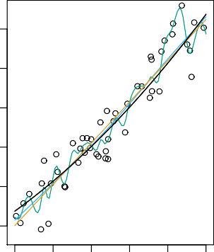
2.5
12
2.0
10
Mean Squared Error
1.5
8
Y
6
1.0
4
0.5
2
0.0
0
20
40
60
80 100
2
5
10 20
X Flexibility
Here the truth is smoother, so the smoother fit and linear model do really well.

Slide 39
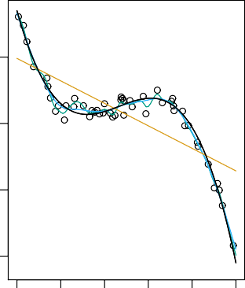
20
20
Mean Squared Error
15
10
Y
10
0
5
−10
0
0
20
40
60
80 100
2
5
10 20
X Flexibility
Here the truth is wiggly and the noise is low, so the more flexible fits do the best.
20 / 30

Slide 40
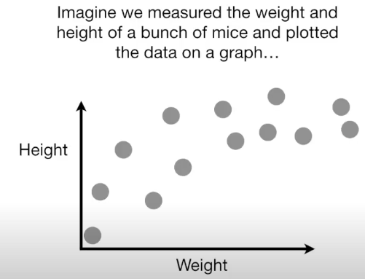
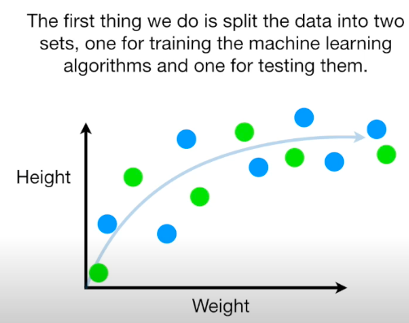
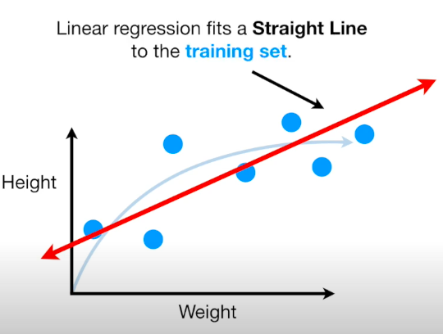
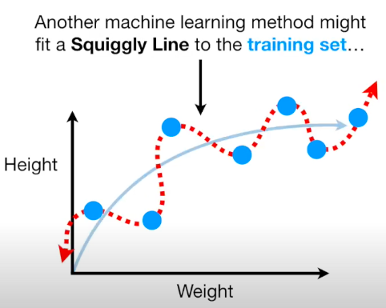
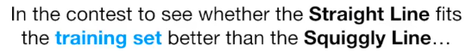
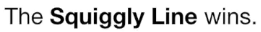
Lets talk about Bias vs Variance

Slide 41
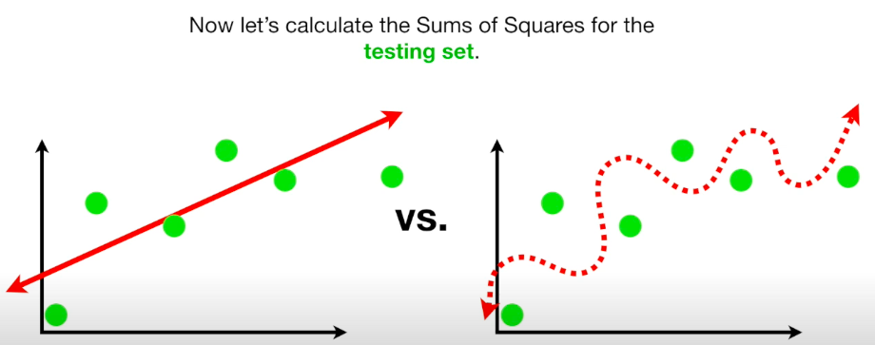
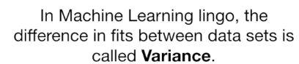
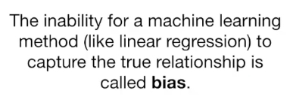
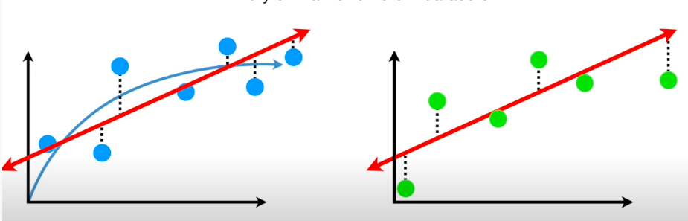
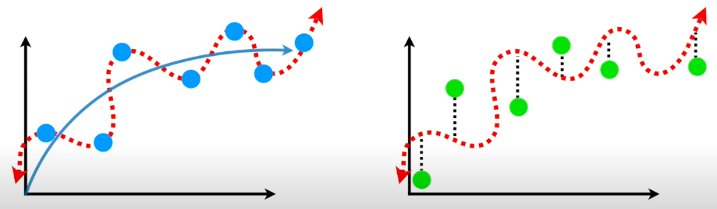
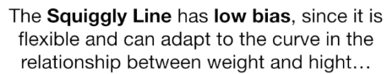
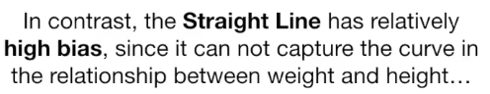



Slide 42




Slide 43
Bias-variance trade-off for the three examples
2.5
2.5
20
MSE
Bias Var
2.0
2.0
15
1.5
1.5
10
1.0
1.0
0.5
0.5
5
0.0
0.0
0
2
5 10 20
2
5 10 20
2
5 10 20
Flexibility
Flexibility
Flexibility
43 / 30

Slide 44


Bias-Variance Trade-off
"Best" model minimizes the test-set MSE, where the true MSE can be decomposed into:
44 / 30

Slide 45

Early stopping
Stop training as soon as the validation error reaches a minimum.

Slide 46
So... how do we deal with flexibility?
GOAL: We want to learn a statistical model that provides a good estimate of f(X) without overfitting
There are two common approaches:
We can split the data into two groups:
training data: data used to train models,
test data: data used to test them
By assessing models using "held-out" test set data, we act to ensure that we get a generalizable(!) estimate of f(X)
We can repeat data splitting k times:
Each observation is placed in the "held-out" / test data exactly once
This is called k-fold cross validation (typically set k to 5 or 10)
k-fold cross validation is the preferred approach, but the tradeoff is that CV analyses take ∼k times longer than analyses that utilize data splitting

Slide 47
Cross Validation
Cross-validation is a resampling procedure used to evaluate machine learning models on a limited data sample.
If you have a machine learning model and some data, you want to tell if your model can fit. You can split your data into training and test set. Train your model with the training set and evaluate the result with test set. But you evaluated the model only once and you are not sure your good result is by luck or not. You want to evaluate the model multiple times so you can be more confident about the model design.

Slide 48
Types of Cross Validation (We will mention only 2)
Train/Test Split (hold-out): It’s a simple and quick way to evaluate a model. The major drawback of this method is that we perform training on the 50% (or 60%, 70%) of the dataset, it may possible that the remaining 50% of the data contains some important information which we are leaving while training our model i.e. higher bias.

Slide 49

Types of Cross Validation K-fold Cross Validation
The general procedure is as follows:
Shuffle the dataset randomly.
Split the dataset into k groups
For each unique group:
Take the group as a hold out or test data set
Take the remaining groups as a training data set
Fit a model on the training set and evaluate it on the test set
Retain the evaluation score and discard the model
Summarize the skill of the model using the sample of model evaluation scores
Bias-Variance Tradeoff: The choice of the number of folds in cross validation can impact the bias-variance tradeoff, i.e., too few folds may result in high bias, while too many folds may result in high variance.

Slide 50


Python implementation for k fold cross-validation

Slide 51

Brief note on reproducibility
An important aspect of a statistical analysis is that it be reproducible. You should:
Record your analysis in a notebook, via, e.g., Jupyter. A notebook should be complete such that if you give it and datasets to someone, that someone should be able to recreate the entire analysis and achieve the exact same results.
Manually set the random-number generator seed before each instance of random sampling in your analysis (such as when you assign data to training or test sets, or to folds):

